Slide 1
Interpretation of the Poem; To an Athlete Dying Young by A. E. Housman
Student
Instructor
Institution
Course

Slide 2
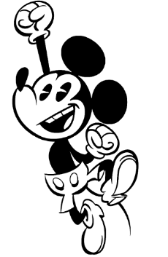
The time you won your town the race/ We chaired you through the market-place;/ Man and boy stood cheering by,/ And home we brought you shoulder-high
You were an exceptional athlete, we always cheered you while at it

Slide 3
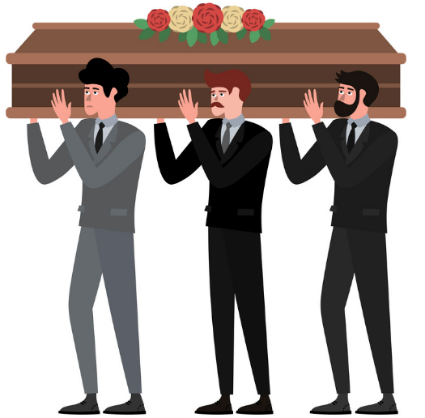
Today, the road all runners come,/ Shoulder-high we bring you home,/ And set you at your threshold down,/ Townsman of a stiller town.
But now you are dead

Slide 4
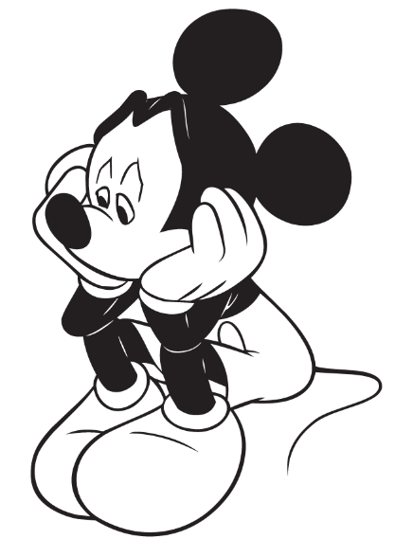
Smart lad, to slip betimes away/ From fields where glory does not stay,/ And early though the laurel grows/ It withers quicker than the rose.
It’s really sad how glory doesn’t last

Slide 5
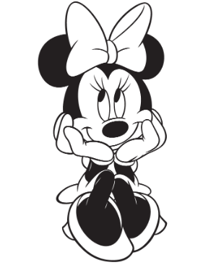
Eyes the shady night has shut/ Cannot see the record cut,/ And silence sounds no worse than cheers/ After earth has stopped the ears:
Does it mean we stay sad forever though?
No! There is beauty in everything, even death.

Slide 6
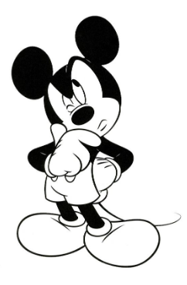
Now you will not swell the rout/ Of lads that wore their honors out,/ Runners whom renown outran/ And the name died before the man.
Don’t you think so?
See, you won’t witness your popularity die like most other athletes…

Slide 7

So set, before the echoes fade,/ The fleet foot on the sill of shade,/ And hold to the low lintel up/ The still-defended challenge-cup.
As we burry you now, we burry you a LEGEND;
with respect and admiration.

Slide 8
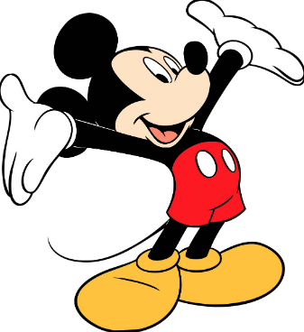
And round that early-laurelled head/
Will flock to gaze the strengthless dead,/
And find unwithered on its curls/ The garland briefer than a girl’s.
And a legend you will remain
FOREVER!

Slide 9
The Connection to Two Literary Devices
Many literal devices were used in the poem. Two of them are assonance and symbolism.
Symbolism
Many ideas have been used in the poem to carry a meaning different from their actual meaning. Some examples include; “laurel” which symbolizes victory, “stiller town” which symbolizes graveyard, and “Home” which symbolizes grave.
Assonance
There are some repeated vowel sounds in the poem. One of them is; “The still-defended challenge-cup”, which has a repeat in the sound /e/.

